Slide 1




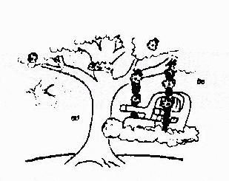
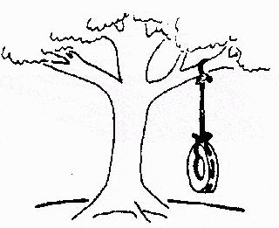
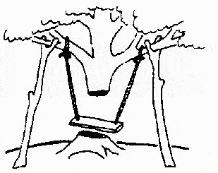
Requirements : Why Important?
This is how the
The requirements specification was defined like this
The developers understood it in that way
problem is solved now
This is how the problem was solved before.
This is how the program is described by marketing department
This, in fact, is what the customer wanted …
That is the program after debugging

Slide 2
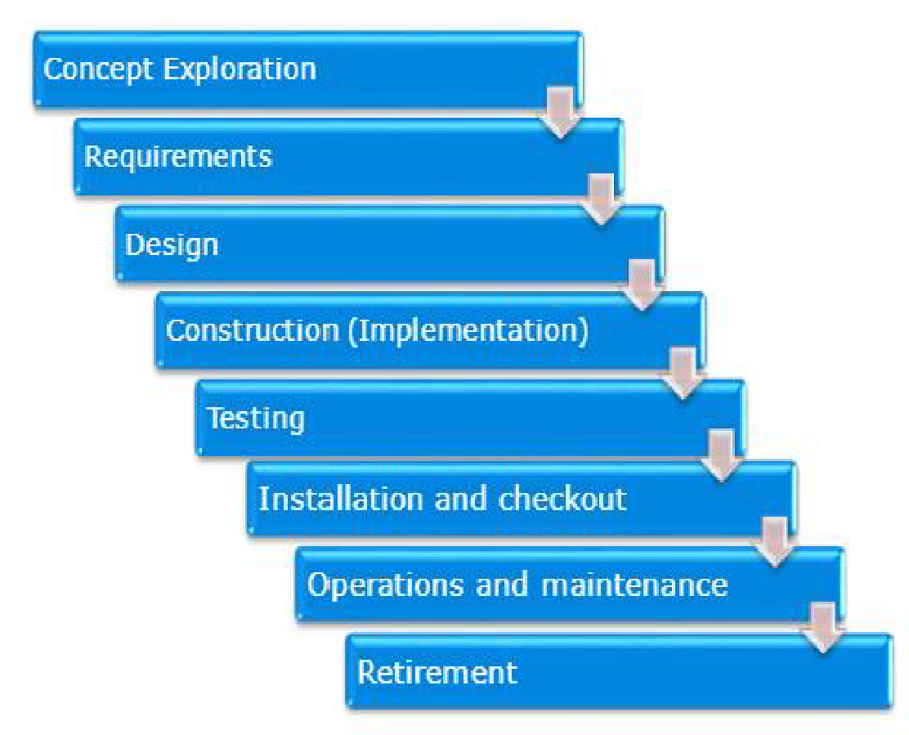
Software Lifecycle
A sample Software Life cycle
Concept Exploration- area where one would like to position the product
Requirements, Design and Construction part of the standard development phase
Testing, installation and Check out the part of the system validation process
Operation and maintenance involves mass deploying the product at customer sites and handling customer issues and entering the maintenance process
Retirement- phasing out the product and introducing the newer one in its place

Slide 3

What are Requirements?
Can we convert physical records to computerised form?

Slide 4
What are Requirements?
“Requirements define what the system must do and how well the system must perform within identified constraints”
Example scenario
To automate records of student in university that were maintained manually.
To support the business processes of the organisation.
To control the process of floor cleaning using robo.
To gather the agriculture data of various states and suitably suggest the manure, fertilizers and pesticides of wide variety of crops
etc.

Slide 5
What are Requirements?
Specify the functionality of software
Establish the interfaces external to the software item.
Provide performance specifications
Set forth the qualification criteria for software testing.
Set forth the human factors engineering specifications for the user interface.

Slide 6
Requirements Specify “What” not “How” !
What and How- Sometimes the requirements analyst may get lost into realising the functionality and specify the design approach for a requirement instead of really documenting what the software shall do
What the software shall do should be documented in detail during the requirement phase.
The How should be the topic of focus during the design phase.

Slide 7
Requirements specify “What” and not “How”!
In a student record management system , consider the feature of entering enrollment number to display the result of a student
Requirement that specifies “how ” (not recommended) : “If the user inputs the enrollment number out of range of the system shall flash an error message in red for 10 seconds ”

Slide 8
Software Requirements: Why Care?
Rework is the major consequence of requirements problems
-Rework can consume 30% to 50% of total development costs
-Requirements errors can account for 70% to 85% of the rework cost
Cost of fixing requirements problems at later stages can be high
-Assume that it costs $1 to fix a requirements defect when still
working on requirements; the cost to fix that defect during
operation can be $100 or more on a relative scale

Slide 9
Software Requirements: Why Care?
Shortcoming in requirements practices can pose many risks to project success
-Where success means delivering a product that satisfies the user's
functional and quality expectations at the agreed upon cost and
schedule
Following sound requirements practices help create high quality products with faster development and delivery times with less effort spent in rework

Slide 10
Cost to change
Software Requirements: Why Care?
Requirements
Design
Construction
Test
Maintenance
Stage

Slide 11
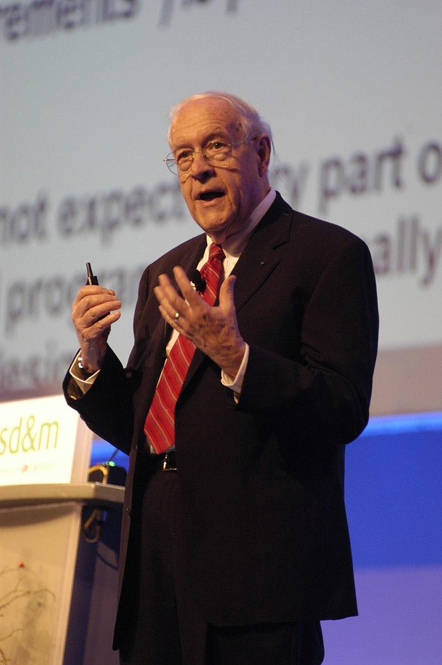
“The hardest single part of building a system is deciding precisely what to build. No other part of the conceptual work is as difficult as establishing the detailed technical requirements, including all interfaces to the people, to machines, and to other software systems. No other part of the work so cripples the resulting system if done wrong. No other part is more difficult to rectify later”
- Frederick P. Brooks Jr

Slide 12
Software Requirements Knowledge Area (KA)
Requirements
elicitation
Requirements
Developments
Requirements
analysis
Software Requirements
Requirements
specification
Requirements
Management
Requirements
validation

Slide 13

Discussion Question
Consider the following requirement: "The system shall have 3-tiers: a web-based presentation tier, logic tier, and data tier that uses a relational database." ?
Is this an acceptable requirement?

Slide 14
Discussion Question
Consider the following requirement: “The system shall have 3-tiers: a web-based presentation tier, logic tier, and data tier that uses a relational database.” Is this an acceptable requirement? ANSWER: Requirements should focus on WHAT is required to be solved by the system and not the HOW part: specifying that the system should consist of 3-tiers is about HOW aspects of the system. Since the requirement talks about the HOW part, this is not an acceptable requirement.

Slide 15
Functional vs. Non-Functional Requirements
Functional requirements | Non-Functional Requirements (NFRs)
Describe the functions that the software is to execute Also known as "capabilities" or "features" | Non-functional requirements are the ones that act to constrain the solution . Also known as "constraints” or “quality requirements”

Slide 16
Functional vs. Non-Functional Requirements
Business objectives
Features
Qualities
Functional Requirements
Usability
Reliability
Robustness
Performance
etc.
Non- Functional Requirements

Slide 17
Exercise: Understanding NFRs
Non-Functional Requirement Name | Description
A. Reusability | How well the system uses the processor capacity space, communication, or band width
B. Efficiency | How easy it is to correct a defect or make a change to the software
C. Testability | Extent to which a component designed for one application can be used in a totally different application
D. Portability | The ease with which the software components or integrated products can be tested
E. Maintainability | Effort required to move or migrate software from one OS to another
F. Usability | Degree to which the system continues to function correctly when confronted with invalid data
G. Robustness | Ease to use and human engineering, user friendliness

Slide 18
Exercise: Understanding NFRs
Non-Functional Requirement Name | Description
A. Reusability | Extent to which a component designed for one application can be used in a totally different application
B. Efficiency | How well the system uses the processor capacity, disk space, communication, or band width
C. Testability | The ease with which the software components or integrated products can be tested
D. Portability | Effort required to move or migrate software from one OS to another
E. Maintainability | How easy it is to correct a defect or make a change to the software
F. Usability | Ease to use and human engineering, user friendliness
G. Robustness | Degree to which the system continues to function correctly when confronted with invalid data

Slide 19
Desirable properties of Set of Requirements
Realistic
Ranked for Importance or Stability
Set of Requirements
Complete
Modifiable
Correct

Slide 20
Desirable Properties of Individual Requirements
cl
Clear
Quantifiable
Concise
Individual Requirements
Prioritized
Consistent
Verifiable
Unambiguous
Traceable
Feasible

Slide 21
Functional Requirements: Examples
In airline tracking system, the system shall assign a unique PNR number to each booking.
Fast Tag in electronic Toll collection system assign UPI Id for making toll payments from customers linked prepaid or saving account.

Slide 22
Non Functional Requirements: Examples
In Airline Tracking System
“Given a PNR number as input, the system should display the status of the flight within 3 seconds to the user (performance requirement).
“The System shall protect against unauthorised addition or deletion of PNR number.” (Security Requirement)

Slide 23
Some Common NFRs… (1)
Availability | Planned uptime, actually available and fully operational. Example : The system should be available 99.999% of the time.
Efficiency | How well the system uses the processor capacity, disk space , communication bandwidth etc.
Flexibility | How much effort is needed to add new capability to the product.
Interoperability | Exchange data or services with other systems.
Reliability | Software executing without failure
Robustness | Degree to which the system continues to function, correctly when confronted with invalid data; also ability to recover from failures

Slide 24
Some Common NFRs…(2)
Usability | Ease of use and human engineering, user friendliness
Maintainability | How easy it is to correct a defect or make a change to the software
Portability | Effort required to move or mitigate software from one platform to another. Example: The system should support the following operating systems: Windows 8.0 and above and Mac OS 8.0 and above.
Reusability | Extent to which a component designed for one application can be used in a totally different application
Testability | Ease with which the software components or integrated products can be tested.

Slide 25
Exercise: Classifying Requirements
FRs : “Functional Requirements” (also called capabilities), state what the software must perform.
NFRs : “Non Functional Requirements” specify the criteria that can be used to judge the operation of the system.
Exercise is to match the requirements in the left-hand-side column with the CLOSEST requirement kind given in the right-hand-side column.

Slide 26
Exercise: Classifying Requirements
Requirement | Functional Requirement (FR) / Non-Functional Requirement(NFR)
A. The system should display the result of the student within 1 second. | Select one of : [FR/ NFR]
B. The date of birth of the student should be displayed in DD/MM/YYYY format | Select one of : [FR/ NFR]
C. The student portal should support 10,000 students of the university at a given point of time. | Select one of : [FR/ NFR]
D. The university website should be available 99.999 % of the time. | Select one of : [FR/ NFR]
E. The student must be able to download the syllabus of the semester as PDF (Portable Document Format) Files. | Select one of : [FR/ NFR]
F. The system should be menu-driven. | Select one of : [FR/ NFR]
G. 80% of the new students registration must be able to take the details in the database within the first 5 minutes of time. | Select one of : [FR/ NFR]

Slide 27
Exercise: Classifying Requirements
Requirement | Functional Requirement (FR) / Non-Functional Requirement(NFR)
A. The system should display the result of the student within 1 second. | Select one of : [FR/ NFR]
B. The date of birth of the student should be displayed in DD/MM/YYYY format | Select one of : [FR/ NFR]
C. The student portal should support 10,000 students of the university at a given point of time. | Select one of : [FR/ NFR]
D. The university website should be available 99.999 % of the time. | Select one of : [FR/ NFR]
E. The student must be able to download the syllabus of the semester as PDF (Portable Document Format) Files. | Select one of : [FR/ NFR]
F. The system should be menu-driven. | Select one of : [FR/ NFR]
G. 80% of the new students registration must be able to take the details in the database within the first 5 minutes of time. | Select one of : [FR/ NFR]

Slide 28
Desirable Properties of Requirements
Clear | Requirements should be written in precise simple language that every reader can understand. Example: How easy is it for a customer to use the system?
Concise | Requirements should describe a single property and expressed with as few words as possible. For Example: in the library automation problem, you should not specify whether the library membership records need to be stored sorted on the member’s first name in a descending order arrangement.
Consistent | No requirement should contradict another. For example: one of the clerks described that a student securing fail grades in three or more subjects should have to repeat the entire semester. Another clerk mentioned that there is no provision for any student to repeat a semester.
Unambiguous | A requirement should have only one interpretation. For example: In a process control application , a requirement expressed by one user is that when the temperature becomes high , the heater should be switched off. Words such as high, low, good, bad etc. are ambiguous without proper quantification.
Feasible | A requirement should be realizable with a specified time frame. Example: It is the probability and percentage of the software performing without failure for a specific number of uses or amount of time.
Traceable | Requirements should be traceable backwards to stakeholder request and forward to software components. Example: It should be possible to trace a specific requirement to the design elements that implement it and vice versa
Verfiable | Requirements must have a clear, testable criterion and cost effective process to check it has been realized as requested. Example: A requirement such as “the system should be user friendly” is not verifiable. On the other hand, the requirement—“When the name of a book is entered, the software should display whether the book is available for issue or it has been loaned out” is verifiable.
Prioritized | Requirements should be prioritized.
Quantifiable | The requirement should be quantifiable, which aids in testing and verifying (that the requirement has been met.

Slide 29
Desirable Properties of Requirements
Realistic | The goals that are represented by the requirements should be attainable within time, resource and cost constraints placed upon the project. Example : Each page must load within 2 seconds. The process must finish within 3 hours so data is available by 8 a.m. local time after an overnight update.
Complete | All the services needed from the system should be included. For example: In a chemical plant automation software, one of the requirements is that if the internal temperature exceeds 200 degree C then the alarm bell must be sounded. However there is no provision for resetting the alarm bell in any of the requirements.
Correct | An SRS is correct if and only if every requirement stated therein is one that the software shall meet.
Modifiable | Changes to the requirements should be able to be made easily, completely and consistently while retaining the structure and style. Example: Customers frequently change the requirements during the software development development due to a variety of reasons. Therefore, in practice the SRS document undergoes several revisions during software development. Also, an SRS document is often modified after the project completes to accommodate
Ranked for importance or stability. | When there are many requirements but limited time or budget, choices must be made about what to include or exclude. Factors such as changes in customer needs, improved developer understanding of the products and changes in organisational policy will affect the stability of requirements.

Slide 30

Example: Verifiable Requirements
The functional : "The white requirement board printer should support printing A2 size sheets" -verifiable as an individual feature
The non-functional requirement (NFR): "The whiteboard printer should complete booting in 2 seconds": verifiable at system level

Slide 31
Emergent Properties
Some requirements represent emergent properties of software that is, requirements that cannot be addressed by a single component but that depend on how all the software components interoperate
-Example: The throughput requirement for a call centre would, for example, depend on how the telephone system, information system, and the operators all interacted under actual operating condition.
Emergent properties are crucially dependent on the system architecture

Slide 32
Quantifiable Requirements: Example
Ambiguous (un-quantified) requirement | Unambiguous (quantified) requirement
The call center software should have higher throughput than the earlier version of the software | The call center's software must increase the center's throughput by 20% when compared to the version 10.1 of the software
The software shall be reliable | The software shall have a probability of generating a fatal error during any hour of operation of less than 1 * 10-8

Slide 33
Quantifying Requirements
Requirement Type | Examples of Measures
Look and feel | Rate of acceptance from users
Usability | Error rates from the users
Performance and speed | Response time from the software
Reliability | Downtime of the software
Portability | Number of platforms supported
Robustness | % of fatal/nonfatal errors
Maintainability | Time and work required to make a change inthe software
Certification | Compliance with standards

Slide 34
System vs. Software Requirements
System requirements focus on the system as a whole | Software requirements are those requirements that are derived from system requirements
Requirements may be allocated to hardware, software, organizational processes or other components of the system | These requirements are allocated to the software - What do we want the software in the system to do?

Slide 35
System vs. Software Requirements
Focus on the system as a whole ("What do you want the system to do?")
System Requirements
Software Requirements
Derived from system requirements ("What do we want the software in the system to do?")

Slide 36
Deriving Requirements
Customer Statement/ Voice of the Customer
Business Use Case
System Requirements
Software Requirements
Specific Use Case

Slide 37
Discussion Question
Important primarily to users | Important to developers
1. Availability | 1. Maintainability
2. Efficiency | 2. Portability
3. Reliability. | 3. Reusability
4. Usability | 4. Testability
Why are the attributes in the table classified as important from the user and developer point of view? Discuss with examples.

Slide 38
Product vs. Process Requirements
Product requirements | Process requirements
What the software must do or what users must be able to do with it | Constraints on development of the software (including specification of a development language or toolset, verification techniques, or the overall process to be followed)

Slide 39
Product Requirements: Examples
For a course registration system in a university: "The software should verify that a student meets all prerequisites before he or she registers for a course“
For a telecommunications billing application:
-“The software should be able to generate 100 bills per second (performance requirement)” -“The software must support Mac OS X and Windows 8.1 and later versions (portability requirement)”

Slide 40
Process Requirements: Examples
For a software embedded in a router device: “The software must be implemented in C language (example of a language constrain)”
For a Networking Management System (NMS) software: “The software must be implemented using Rational Unified Process (RUP) method (example of a process constraint)”

Slide 41
Requirements Process Model
The requirements process takes a business or engineering problem and, from it, creates the specifications for a system that will provide a solution to that problem
This generic process model shows four sets of activities to produce specifications from business or engineering problem
Requirements elicitation
Requirements analysis
Requirements specification
Requirements validation

Slide 42
Requirements Process Model
Elicitation
Analysis
Specification
Validation
clarity
Close gaps
rewrite
Re – evaluate
Confirm and correct

Slide 43
Requirements Process Activities
Requirements Process Activity | Short Description
Requirements elicitation | The process of gathering or discovering the requirements
Requirements analysis | The process of reviewing the requirements, understanding requirements them as individual requirements and in the larger context of all requirements, and synthesizing them to specify a solution
Requirements specifications | The creation of the software and system specification documents
Requirements Validation | The set of formal and informal reviews and other techniques that help ensure that the requirements will produce a product that will meet the customer’s needs when operated in its intended environment

Slide 44

Process Actors / Stakeholders
Requirements
engineer/software
engineer
Users
Regulator
Customers
Software Engineers
Market Analysts
Testing Team

Slide 45
Process Stakeholders
Stakeholders are people who have an interest in the software engineering project/product
It is important to identify stakeholders early in the process
This will help us ensure that all sources of requirements are included
It will not be possible to perfectly satisfy the requirements of every stakeholder
- It is the software engineer's job to negotiate tradeoffs that are both acceptable to the principal stakeholders and within budgetary, technical, regulatory, and other constraints

Slide 46
Typical Process Stakeholders
Role | Use of Requirements
Project leader | Determine scope and create project plan Get agreement from owners Track progress
Analyst | Elicit requirements Decompose requirements
Development team | Design and code to requirements Engineer efficiency and reuse
Test team | Verify conformance to requirements
Project Sponsor | Provide motivation and sign off
Maintenance team | Support users in production. Ensure changes fit requirements

Slide 47
Review Question
You are a requirements analyst working on gathering or discovering the requirements by interviewing various project stakeholders. Which requirements process activity are you performing?
a) Requirements elicitation
b) Requirements analysis
c) Requirements specification
d) Requirements validation

Slide 48
Requirements Elicitation
Requirements elicitation is the process of working proactively with all stakeholders gathering their needs, articulating their problem, identify and negotiate potential conflicts thereby establishing a clear scope and boundary for a project
It can also be described as a process of ensuring that the stakeholders have been identified and they have been given an opportunity to explain their problem and needs. And describe what they would like the new system to do

Slide 49
Dimensions of Requirements Elicitation
Requirements elicitation: Dimension | Understanding the problem
 | Understanding the domain
 | Identifying clear business objectives
 | Understanding the needs
 | Understanding constraints of the system stakeholders
 | Writing business objectives for the project

Slide 50
Requirement Sources
High Level Goals
Feasibility
study
Stakeholders and System Context
Operational Environment
Requirements Elicitation
Focus Groups
Understanding problem
Write Business Objectives
Gather Information from Stakeholders
Organizational
Environment

Slide 51
Goals
The "goal" (sometimes called "business concern" or "critical success factor") refers to the overall, high-level objectives of the software
Goals provide the motivation for the software but are often vaguely formulated.
A "feasibility study" is a relatively low-cost way to assess the viability or practicality of realizing the goals

Slide 52
Interviews
Interviewing stakeholders is a "traditional" means of eliciting requirements
Advantages | Disadvantages
Effective to get an overall understanding of what stakeholders do and how they are likely to interact with the system | Stakeholders language is so filled with business-related jargon hard for engineers to understand. Stakeholders find some key activities so familiar that they miss mentioning them

Slide 53
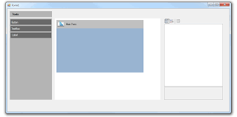
Prototypes
Prototyping technique is a valuable tool for clarifying ambiguous requirements.
Wide range of prototyping techniques available ranging from paper mockups of screen designs to beta-test versions of software products
GUI Builder
GUI

Slide 54
Facilitated Meetings
Stakeholders brainstorm and refine ideas in a meeting facilitated by a moderator
Advantages | Disadvantages
Bring more insight into their software requirements than by working individually. Conflicting requirements surface early Result in a richer and more consistent set of requirements | Critical abilities of the team may get eroded by group loyalty Concerns of a few outspoken (and perhaps senior) people may get favoured to the detriment of others

Slide 55
Observation
When using observation technique, software engineers learn about user tasks by immersing themselves in the environment and observing how users perform their tasks by interacting with each other and with software tools and other resources.

Slide 56
User Stories
Refers to short, high-level descriptions of required functionality expressed in customer terms
A user story is intended to contain just enough inform so that the developers can produce a reasonable esti of the effort to implement it
User stories is a commonly used technique in Agile Methods computer society

Slide 57
User Stories: Template
Template “As a <role>, I want <goal/desire> so that <benefit>” Example “As a buyer, I want the check out page to have “confirm” button so that I can review the order before paying the money”

Slide 58
Choosing Elicitation Technique(s)
Elicitation technique to choose depends on nature of the system being developed
– For example a UI intensive system needs a different approach compared to an embedded system
In the Ul system the navigation and behavior is visible to all, hence easy to comprehend
Also depends on preferences of stakeholders
–If the stakeholder is very hands-on, prototyping and simulation would work –For non-computer savvy stakeholders, documents or discussion would be more suitable

Slide 59
Case Study 1 - GGSIPU’s Centralized Authentication System (CAS)
Problem Statement
As an organization GGSIPU is expanding which leads to the increase in the number of systems, applications, and services that require authentication and authorization. This often leads to a proliferation of disparate authentication systems that may not integrate well with each other. This creates several issues, such as difficulties in managing user credentials, increased risk of security breaches, and inconsistent user experiences.
Furthermore, maintaining multiple authentication systems can be costly in terms of time, money, and resources. Additionally, different authentication systems may have different security policies, which can make it challenging to ensure compliance with regulations and standards.
Therefore, there is a need for a GGSIPU’s Centralized Authentication System (CAS) that can provide a unified and secure method for authenticating users across all systems, applications, and services within an organization. This system should be able to integrate with existing authentication systems and provide a consistent user experience while also ensuring compliance with security policies and regulations. The purpose of this SRS is to define the requirements for such a CAS.

Slide 60
Introduction
The purpose of this document is to define the requirements for a CAS that provides a unified and secure method for authenticating users across all systems, applications, and services within an organization. This system will integrate with existing authentication systems and provide a consistent user experience while ensuring compliance with security policies and regulations.
Scope
The CAS will be a centralized system that will provide authentication and authorization services for all systems, applications, and services within GGSIPU. It will integrate with all future applications and provide a single sign-on (SSO) experience for users.

Slide 61
System Requirements
Following are the CAS requirements in detail:
A web-based interface for anytime anywhere access by employees, deans and incharges of respective departments and personnel departments for log in to the CAS and its integrated applications.
A single sign on based authentication and authorization system to ensure secure access to the system. It shall be able to provide a dashboard allowing a user to switch between all the integrated applications without providing their credentials.
A database to store employees’ official information with their official information which is common and which shall be shared across the applications .
The ability to provide authentication and authorization services to all the existing and future applications across the GGSIPU digital ecosystem.
User Roles
The CAS will have the following user roles:
Employee: An employee will be able to view their personal and official details and be able to visit the integrated applications through a dashboard as per his authorization.
Administrator: An administrator will have full access to the CAS and will be able to configure system settings, manage masters and generate audit reports. The Administrator will also be responsible for the registration, activation of applications and other tasks related to employee management. The Administrator shall also be able to create new roles with overlapping capabilities as per the future requirements.
Monitor: This role will have complete viewable access to the entire system without actions. The monitoring user will be able to view the information in rollup and drill down fashion of the entire institute.

Slide 62
Workflow
The CAS workflow will consist of the following steps:
An employee logs into the system and upon login he will be shown a list of integrated applications in the form of a dashboard.
On clicking the selected application, he will be redirected to that application’s landing page.
Security
The CAS will include the following security measures:
1. Secure login and password management to ensure only authorized users can access the system.
2. Security hardening and session management as per the latest secure coding and session management practices.
3. Hardening of the web server as per the latest available security guidelines.
4. Regular backups of the database to ensure data is not lost in case of a system failure.

Slide 63
Use Case Diagram
The actors in the CAS are the various individuals or entities that interact with the system to accomplish different tasks. Here are some of the key actors in the CAS:
External Application User: This type of user is the primary actor in the CAS. They will log in to the system by providing user credentials such as Username and Password. Once successful login to the system, the user will be provided a list of applications mapped to his user id in the form of a dashboard, and it allows the user to redirect to the application using single sign on facility, i.e. without entering username and password.
Login Administrator: The login administrator is responsible for registration and deregister a user login, assigning or modifying a role of a user. He/She will be also responsible for handling the request of unblocking of the user account, if any.
Service Administrator: The service administrator is responsible for registration, activation, deactivation of integrated applications with the CAS, including setting up mode of integration, type of security and monitoring of the application logs.
System Administrator: The system administrator is responsible for managing the CAS, including setting up the system, managing user access, and generating security compliance reports.
Data Entry Operator: The DEO is responsible for entering/updating employee details, post creation/updation, allocation and relieving of employees to/from a post, generating employee and post based reports.

Slide 64
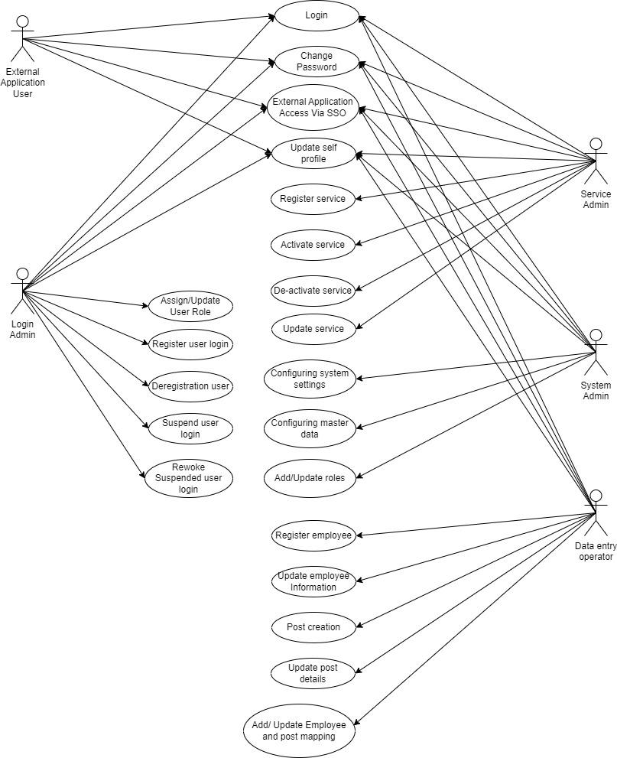
Use Case Diagram of CAS

Slide 65
Functional Requirements
User Authentication: The CAS shall authenticate users based on their username and password credentials. The CAS shall support multi-factor authentication methods, including but not limited to SMS-based one-time passwords (OTP). The CAS shall enforce password policies, including complexity, length, and expiration. The CAS shall support password recovery mechanisms.
User Authorization: The CAS shall authorize users based on their assigned roles and permissions. The CAS shall support the assignment and management of roles and permissions for users. The CAS shall enforce access control policies for users based on their roles and permissions.
Single Sign-On (SSO): The CAS shall provide a single sign-on (SSO) experience for users across all future systems, applications, and services. The CAS may support SSO integration with existing authentication systems depending on the technical capability of the existing applications. The CAS shall support session management for SSO and also provide a provision to integrate the applications which requires only one time authentication without SSO features.
Security: The CAS shall enforce security policies, including but not limited to authentication and authorization policies. The CAS shall use industry-standard encryption algorithms for secure communication. The CAS shall support auditing and logging of authentication and authorization events. The CAS shall comply with applicable security regulations and standards.
Usability: The CAS shall provide a user-friendly and intuitive interface for authentication and authorization. The CAS shall provide clear and concise error messages for authentication and authorization failures.

Slide 66
Non Functional Requirements
Non-functional requirements for the CAS for 5000 employees include:
Scalability: The CAS shall support at least 5000 concurrent users. The CAS shall provide fast and responsive authentication and authorization services. It shall also have the ability to scale up to accommodate additional users as the number of employees grows. The CAS shall support horizontal and vertical scaling.
Performance: The system should have a response time of no more than 3 seconds for the 99.9% of the time when an employee submits or views their leave application, even during peak usage periods. The CAS shall provide high availability and fault tolerance.
Compatibility The CAS shall be compatible with existing authentication systems and applications.
Security: The system should use secure protocols such as HTTPS and have role-based access control to ensure that only authorized personnel have access to employee leave records. The system should comply with the latest CERT security guidelines and pass through all the security audit processes.
Reliability: The system should have an uptime of at least 99.9% and be able to recover from any failures or disruptions within 30 minutes.
Maintainability: The system should be designed to be easily maintainable, with documentation provided to guide administrators in performing updates, backups, and maintenance tasks. The system is expected to run 24 X 7, although there would be a scheduled downtime of one hour every month for the regular maintenance activities.
User Experience: The system should be easy to use, with a simple and intuitive interface that requires no more than 30 minutes of training for new users.
Compliance: The system should comply with relevant government laws and GGSIPU policies, including rules for managing employee leave entitlements and handling leave requests and approvals.
Integration: The system should be able to integrate with all the existing division’s systems such as payroll and employee data management systems to provide them authentication and authorization services.
Constraints: The CAS shall be developed using industry-standard software development methodologies and tools. The CAS shall be compatible with the organization's existing technology stack and infrastructure.
Assumptions and Dependencies: The development and deployment of the CAS will depend on the availability of appropriate hardware and software resources. The CAS will assume that users have appropriate access to systems, applications, and services based on their roles and permissions.

Slide 67
Conclusion
The Central Authentication System (CAS) will provide a centralized and secure method for authenticating users across all systems, applications, and services within an organization. It will integrate with existing authentication systems and provide a consistent user experience while ensuring compliance with security policies and regulations.

Slide 68
ER Diagram of CAS
n
1
1
n
Organisation
Employee
1
1
Login
1
n
Role
1
n
App Master

Slide 69
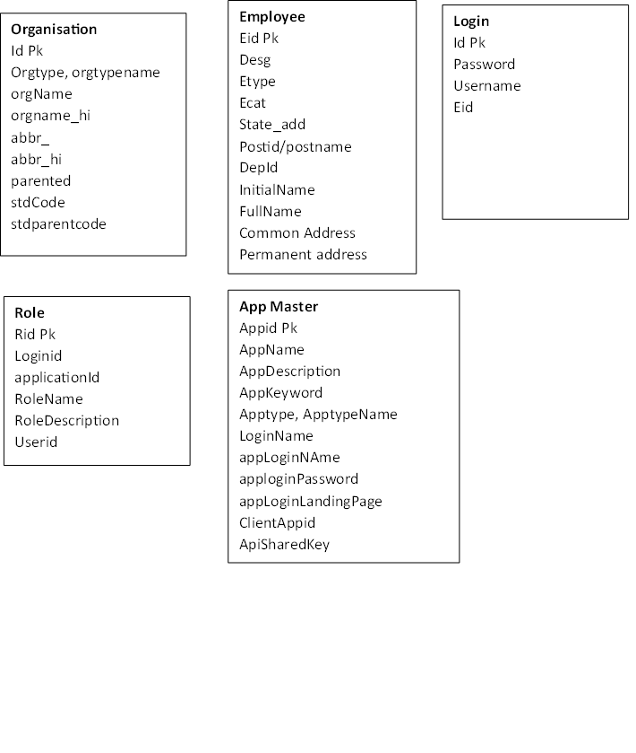
ER 1NF

Slide 70
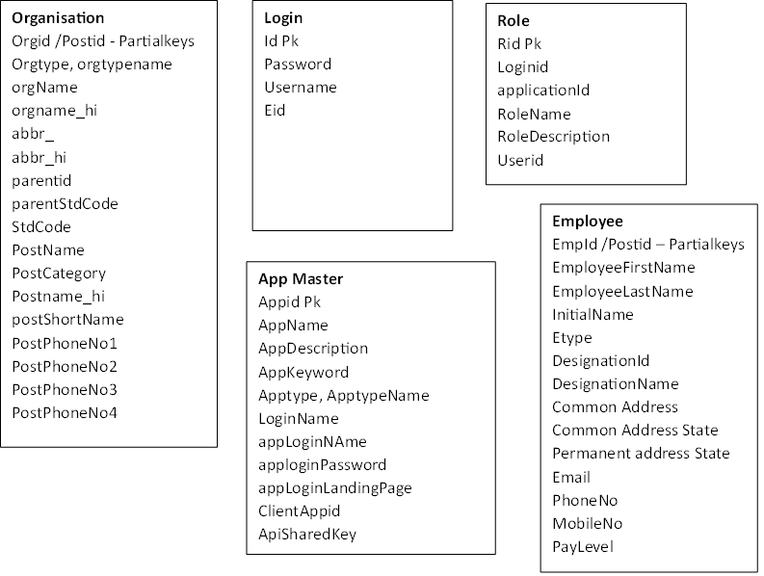
ER 2NF

Slide 71
ER 3NF
n
1
1
n
1
n
Organisation
Post
User Post
Allocation
n
1
1
1
Employee
Login
1
n
1
n
1
n
Role
App Master
Rest Service Log

Slide 72
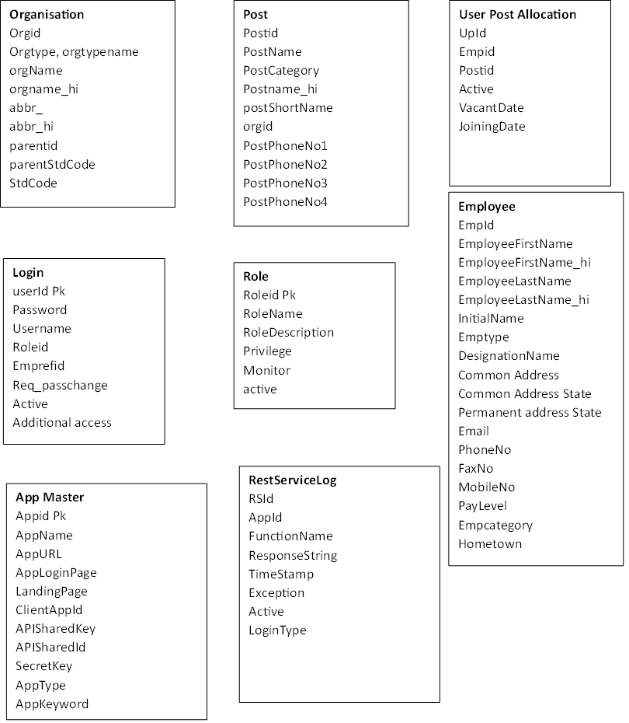
ER-3NF

Slide 73
DFD(Data Flow Diagram) level 0- CAS
ORGANIZATION MANAGEMENT
USER MANAGEMENT
EMPLOYEE MANAGEMENT
Authentication System
PASSWORD MANAGEMENT
ROLE MANAGEMENT
LOGIN MANAGEMENT
APPLICATION MANAGEMENT
REGISTER MANAGEMENT
POST MANAGEMENT

Slide 74
USER MANAGEMENT
USER MANAGEMENT
USER REPORT
PASSWORD MANAGEMENT
PASSWORD MANAGEMENT
PASSWORD UPDATE REPORT
LOGIN MANAGEMENT
LOGIN MANAGEMENT
SIGNED IN AUDIT REPORT
REGISTER MANAGEMENT
REGISTER MANAGEMENT
Authentication System
REGISTRATION REPORT
ORGANIZATION MANAGEMENT
ORGANIZATION MANAGEMENT
ORGANIZATION MAPPING CHART
EMPLOYEE MANAGEMENT
EMPLOYEE MANAGEMENT
EMPLOYEE REPORTING CHART
ROLE MANAGEMENT
ROLE MANAGEMENT
APPLICATION REPORT
APPLICATION MANAGEMENT
APPLICATION MANAGEMENT
ORGANIZATION POST MAPPING CHART
POST MANAGEMENT
POST MANAGEMENT

Slide 75
Case Study 2- The GGSIPU Leave Management System (GGSIPU-LMS)
Problem Statement
A web based Leave Management System is required for Guru Gobind Singh Indraprastha University (GGSIPU) where employees should be able to apply for leave online which is processed by the competent authority online along with maintenance of the leave record by the authorized personnel. The leave must be sanctioned as per policy formulated by GGSIPU for different leave types.

Slide 76
Introduction
The GGSIPU Leave Management System (GGSIPU-LMS) is a software application designed to automate the process of managing leaves of employees of GGSIPU. This system will allow employees to apply for leave, view their leave history, and approve or reject leave requests, if authorized. The personnel department will also have the ability to approve or reject leave requests, if authorized, although they will be able to view the leave status of all employees.
Purpose
The purpose of the GGSIPU-LMS is to streamline the leave management process and improve communication between employees and personnel departments. The system will provide a common dashboard for managing leave requests of all types, and it will enable automation of the complete leave management process.

Slide 77
System Requirements
Following are the GGSIPU-LMS requirements in detail:
A web-based interface for anytime anywhere access by employees, deans and incharges of respective departments and personnel departments.
A single sign on based authentication and authorization system to ensure secure access to the system.
A database to store employees’ official information with their leave information.
The ability to send notifications to employees and their deans or respective in-charges at every event of leave requests, rejection, approvals, etc.
The ability to generate numerous reports on leave usage and employee attendance in drill down and roll up fashion.
User Roles
The GGSIPU-LMS will have the following user roles:
Employee: An employee will be able to view their leave history, apply for leave, and view the status of their leave requests.
Forwarder: A forwarder will be able to forward or reject leave requests, view the leave status of their employees, and generate reports on leave usage.
Approver: An approver will be able to approve or reject leave requests, view the leave status of their employees, and generate reports on leave usage.
Administrator: An administrator will have full access to the GGSIPU-LMS and will be able to configure system settings, manage masters and generate reports.
Monitor: This role will have complete viewable access to the entire system without actions. The monitoring user will be able to view the information in rollup and drill down fashion of the entire institute.

Slide 78
Workflow
The GGSIPU-LMS workflow will consist of the following steps:
An employee logs into the system and applies for leave for a specific leave type or combination of leave types.
The leave request is sent to the employee's approver/forwarder as per approval chain.
The approver/forwarder approves/forwards/rejects the leave request.
If the leave request is approved, the employee's leave balance is updated, and the employee is notified.
If the leave request is rejected, the employee is notified and can apply for leave again.
If the leave request is forwarded, the leave gets into the account of the approver for final approval and the employee is notified accordingly.
Security
The GGSIPU-LMS will include the following security measures:
Secure login and password management to ensure only authorized users can access the system.
Security hardening and session management as per the latest secure coding and session management practices.
Hardening of the web server as per the latest available security guidelines.
Regular backups of the database to ensure data is not lost in case of a system failure.

Slide 79
Use Case Diagram
The actors in the GGSIPU-LMS are the various individuals or entities that interact with the system to accomplish different tasks. Here are some of the key actors in the GGSIPU-LMS:
Employee: The employee is the primary actor in the GGSIPU-LMS. They can be teaching or non-teaching staff members having their individual leave entitlements and leave rules. They can submit leave requests, view their leave balances, check the status of their leave requests, and submit cancellation for their existing leave requests.
Forwarder/Reporting Personnel: The Reporting personnel is responsible for approving or rejecting employee leave requests. They can also view the leave requests of their team members, schedule leave.
Approver/Personnel Department Member: The personnel department is responsible for managing the overall leave policy of the organization, ensuring compliance with institute’s policies, and generating reports on employee leave. They will be able to approve or cancel the leave request, and manage the leave balances of all the employees.
System Administrator: The system administrator is responsible for managing the leave management system, including setting up the system, managing user access, and generating security compliance reports.
Accounts department member: The accounts department member is responsible for ensuring that employee leave is accurately reflected in their service book, including deductions for unpaid leave, if any.
Monitoring user/Vice Chancellor (VC) office: The VC office will be provided with monitoring access to the GGSIPU-LMS ensuring read only access to the entire information in rollup and drill down fashion. The VC office can view the real time leave records at the institute/school/department level ensuring compliance with institute’s leave policies.

Slide 80
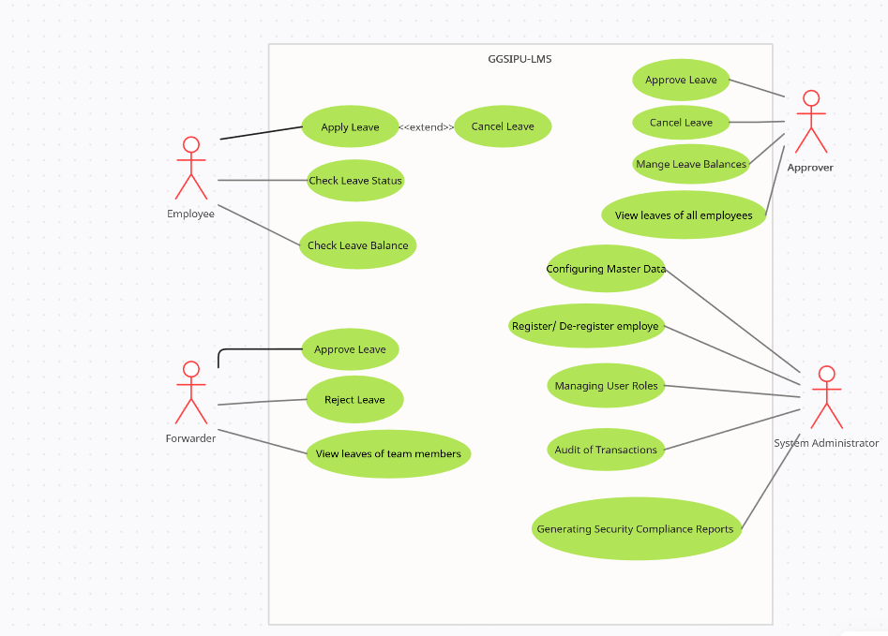
Use Case Diagram of GGSIPU-LMS

Slide 81
Non Functional Requirements
Non-functional requirements for the GGSlPU-LMS for 5000 employees include:
Scalability: The system should be able to handle at least 5000 active users simultaneously and have the ability to scale up to accommodate additional users as the number of employees grows.
Performance: The system should have a response time of no more than 3 seconds for the 99.9% of the time when an employee submits or views their leave application, even during peak usage periods.
Security: The system should use secure protocols such as HTTPS and have role-based access control to ensure that only authorized personnel have access to employee leave records. The system should comply with the latest CERT security guidelines and pass through all the security audit processes.
Reliability: The system should have an uptime of at least 99.9% and be able to recover from any failures or disruptions within 30 minutes.
Maintainability: The system should be designed to be easily maintainable, with documentation provided to guide administrators in performing updates, backups, and maintenance tasks. The system is expected to run 24 X 7, although there would be a scheduled downtime of one hour every month for the regular maintenance activities.
User Experience: The system should be easy to use, with a simple and intuitive interface that requires no more than 30 minutes of training for new users.
Compliance: The system should comply with relevant government laws and GGSIPU policies, including rules for managing employee leave entitlements and handling leave requests and approvals.
Integration: The system should be able to integrate with other personnel division’s systems such as payroll and employee data management systems to ensure that all employee data is consistent and up-to-date.

Slide 82
Case Study 3: Human Resource Management System
(User Requirements)
The user requires that the human resources system provide the following business processes.
1.0 Employee Maintenance
1.1 Add an employee by entering
Employee information
Salary or hourly rate information
Dependent's information
The location must be a valid location in the Fixed Asset System (FAS).
The hourly rate is converted to U.S. dollars. The currency data is accessed from the Currency Application System (CAS) in order to convert a standard hourly rate in U.S. dollars based upon the currency location of the employee.

Slide 83
Example User Requirements Contd...
1.2 Update employee information
Update any employee information except the social security number (SSN).
The location must be a valid location in the Fixed Asset System. The hourly rate is converted to U.S. dollars. The currency data is accessed from the Currency Application System (CAS) in order to convert a standard hourly rate in U.S. dollars based upon the currency location of the employee.
1.3 Delete employee information
Delete all information about an individual employee. When deleting an employee currently assigned to a job, update the job assignment to set the status to inactive.
1.4 Inquire on an individual employee
Using an employee SSN, view all information about that specific employee.
1.5 View a list of employees
Retrieve a list of employees to view. This view totals the number of employees.

Slide 84
Example User Requirements Contd...
2.0 Job Maintenance
2.1 Add job information by entering
Name Number Pay grade
Description information
The user considers job description to be free form text that is not maintained independently from the job.
2.2 Update job information
Update any job information except the job number.
2.3 Delete job information
Delete all information about a job. When deleting a job currently assigned to an employee, update the job assignment to set the status to inactive.
2.4 Inquire on an individual job
Using the job number, view all information about a specific job.
2.5 View a list of jobs
Retrieve a list of jobs to view. This view totals the number of jobs.

Slide 85
Example User Requirements Contd...
3.0 Job Assignment Maintenance
3.1 Assign an employee to a job
Add job assignment information by entering the following information for each job and employee.
Effective date
Salary
Performance rating
3.2 Transfer employee
An employee can be transferred to different job assignments.
3.3 Delete job assignment information
Delete a job assignment for an employee.
3.4 Inquire on an individual job assignment
Using the job number and employee social security number, view all information about a specific job assignment.
3.5 View a list of job assignments.
Retrieve a list of active job assignments. This view totals the number of employees assigned to each job.

Slide 86
Example User Requirements Contd…
4.0 Inquire on location information
4.1 The user requires the ability to inquire on employees and their location. The location data is for reference only . It is maintained by the Fixed Asset System.

Slide 87
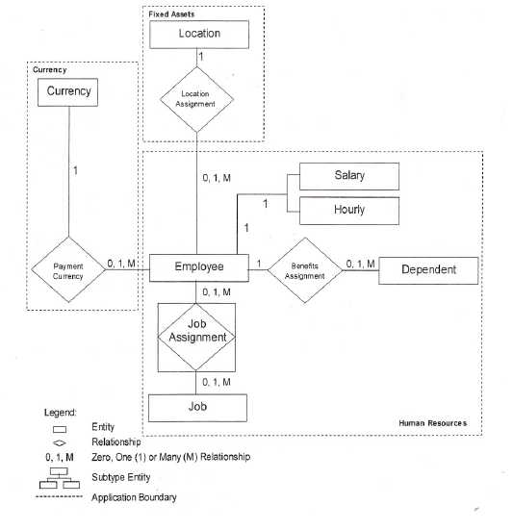
Example ER Diagram

Slide 88
Example ER Diagram Contd…
Entity Attributes
CURRENCY entity type
Currency_Location
Base_Currency
Conversion_Rate_To_Base_Currency
Date Of Rate
EMPLOYEE entity type
Employee_Name
Social_Security_Number
Nbr_Dependents
Type_Code
SALARJED_EMPLOYEE entity subtype
Supervisory_Level
HOURLY_EMPLOYEE entity subtype Standard_Hourly_Rate
US_Hourly_Rate Collective_Bargaining_Unit_Number
DEPENDENT entity type
Dependent_Social_Security_ Number
Dependent_Name
Dependent_Birth_Date

Slide 89
Example ER Diagram Contd…
Entity Attributes
JOB entity type
Name
Number
Pay_Grade
Description
LOCATION entity type
Location Name
Address
City
State
Zip
Country
JOB_ASSIGNMENT entity type
Effective Date
Salary
Performance_Rating
Status Inactive
System_Date

Slide 90
Example ER Diagram Contd…
Attributes Relationships
Attribute | Established Relationship For
Currency_Location | CURRENCY and EMPLOYEE
Location_Name | EMPLOYEE and LOCATION
Social_Security_Number | EMPLOYEE and DEPENDENT
Social_Security_Number | EMPLOYEE and JOB_ASSIGNMENT
Job_Number | JOB and JOB_ASSIGNMENT

Slide 91
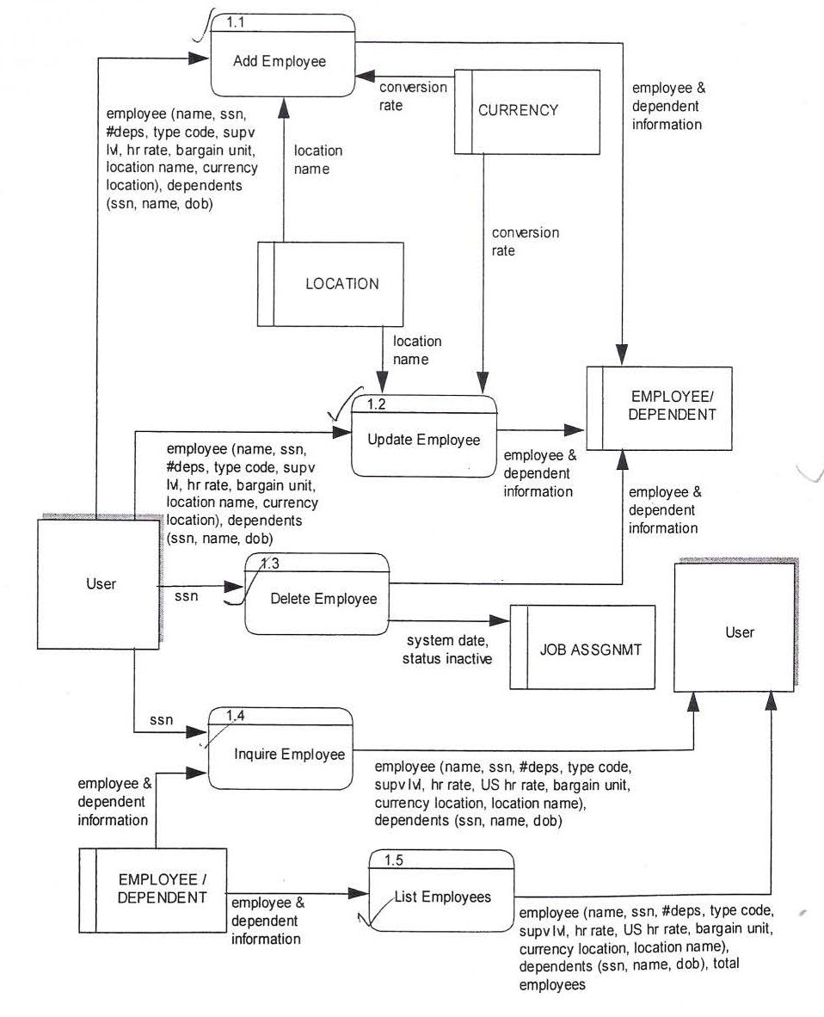
Example Data Flow Diagram
Employee Maintenance
for the process to maintain employee information.

Slide 92
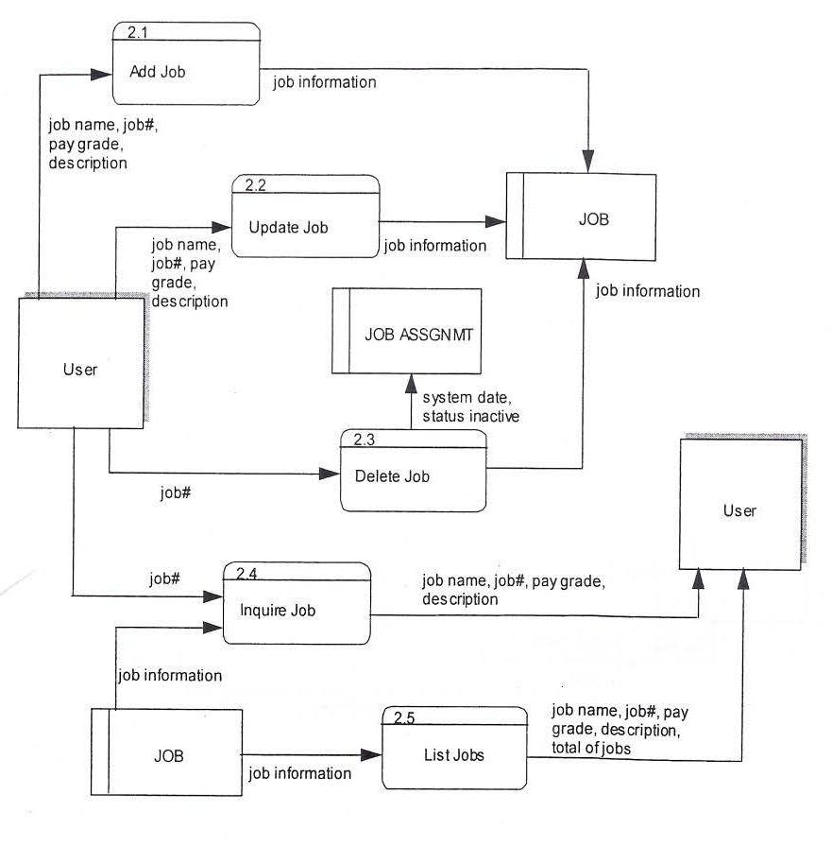
Example Data Flow Diagram
Job Maintenance
for the process to maintain job information.

Slide 93
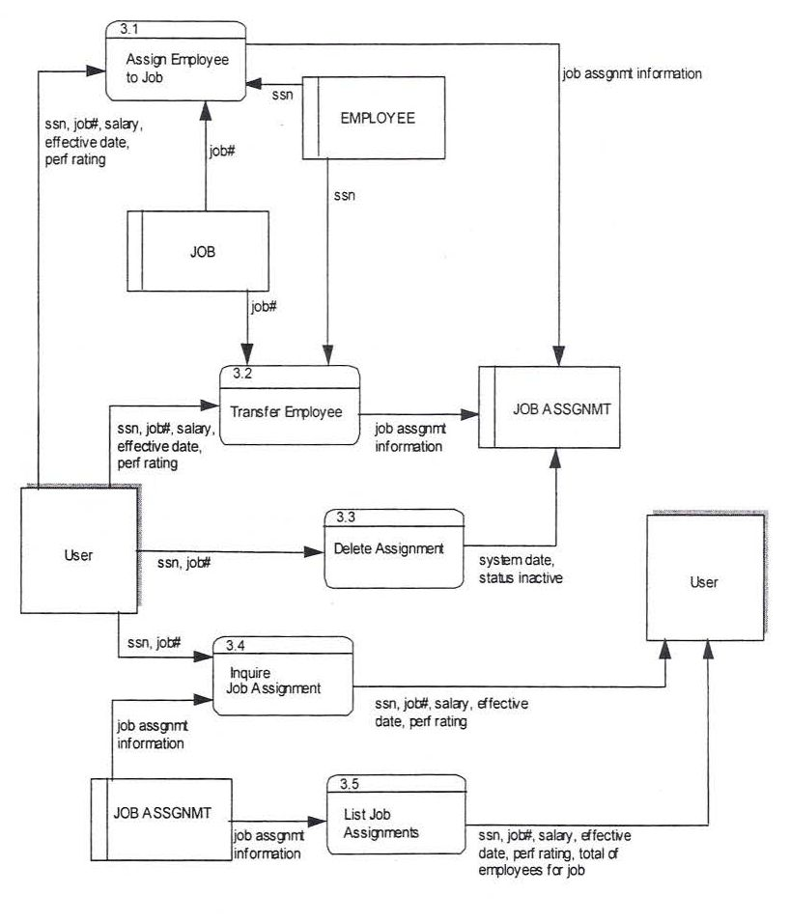
Example Data Flow Diagram
Job Assignment Maintenance
for the process to maintain job assignment information.

Slide 94
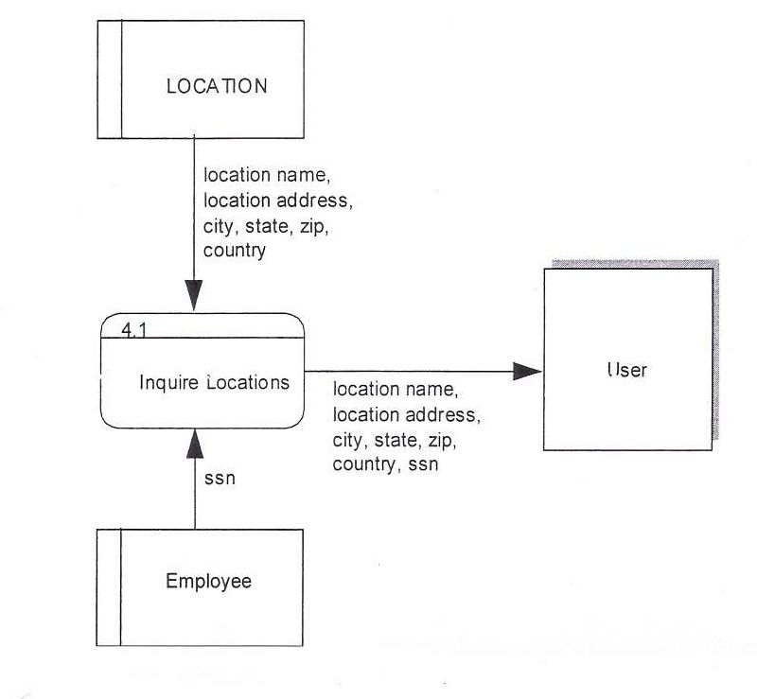
Example Data Flow Diagram
Location Reporting
for the process to report location information.

